Slide 1

INSTITUTE : UIE
DEPARTMENT : CSE
Bachelor of Engineering (Computer Science & Engineering)
PROJECT BASED LEARNING IN JAVA
(20CST-319/20ITT-319)
TOPIC OF PRESENTATION:
Configuring various types of drivers for Java Database Connectivity, MVC Model for project development.
DISCOVER . LEARN . EMPOWER

Slide 2
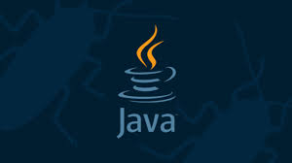
Lecture Objectives
In this lecture, we will discuss:
Configuring various types of drivers for Java Database Connectivity, MVC Model for project development.

Slide 3
JDBC ARCHITECTURE/JDBC Driver Types
Type 1
JDBC-ODBC Bridge
Type 2
Native API, partially java driver
Type 3
JDBC Network Driver, partially java
Type 4
Native-protocol pure Java driver (100% Java )

Slide 4
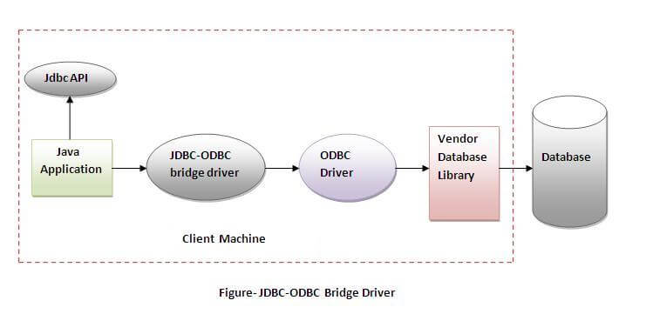
JDBC ARCHITECTURE/JDBC Driver Types
Type 1 Driver: JDBC-ODBC Bridge Driver
Translate JDBC into ODBC and use Windows ODBC built in drivers
ODBC must be set up on every client
driver must be physically on each machine for both java applications and applets
for server side applications, ODBC must be set up on web server
driver oracle.jdbc.odbc.JdbcOdbc provided by JavaSoft with JDK
Eg: JDBC-ODBC Bridge that comes with JDK 1.2

Slide 5
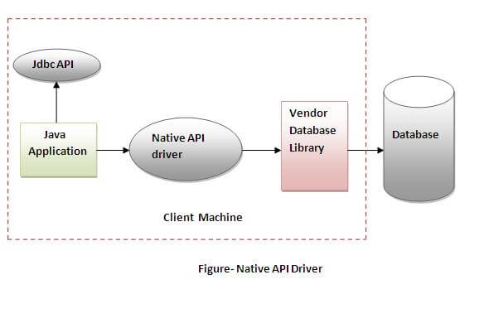
JDBC ARCHITECTURE/JDBC Driver Types
Type 2 Driver: JDBC-Native API
Native-API partly-Java driver converts JDBC calls into calls on the client API for Oracle, Sybase, Informix or other DBMS
like Type 1 drivers; requires installation of binaries on each client & not suitable for large networks.
Eg: Oracle Call Interface (OCI) driver.

Slide 6
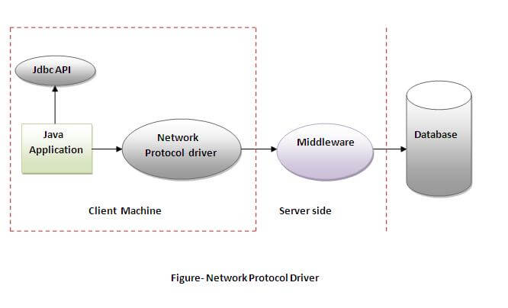
JDBC ARCHITECTURE/JDBC Driver Types
Type 3 Driver: JDBC-Net pure Java
three-tier approach is used to access databases. The JDBC clients use standard network sockets to communicate with a middleware application server.
The middleware connects its pure Java clients to many different databases. The type of protocol in this middleware depends on the vendor.
Most flexible driver type

Slide 7
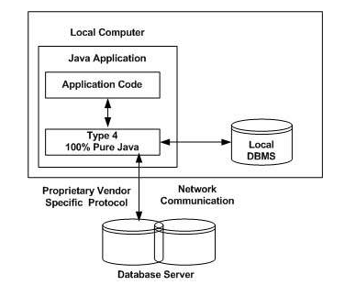
JDBC ARCHITECTURE/JDBC Driver Types
Type 4: 100% Pure Java
Converts JDBC directly to native API used by the RDBMS
Requests from client machines are made directly to the DBMS server.
Compiles into the application, applet & does not require anything to be installed on client machine, except JVM
They are also written in 100% Java and are the most efficient among all driver types.
Eg: MySQL's Connector/J driver is a Type 4 driver.

Slide 8
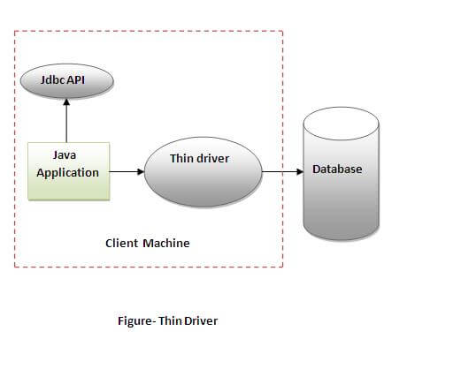
JDBC ARCHITECTURE/JDBC Driver Types
A Type 4 driver is a pure Java driver, which usually comes as a .jar file and performs direct calls to the database server. It does not need any configuration on the client’s machine, other than including the name of the main driver’s class in your Java code. That’s why it’s also known as the thin driver.
For example, Java applets can be packaged with this type of driver, which can be automatically downloaded to the user’s machine along with the applets themselves.

Slide 9
Which Driver should be Used?
If you are accessing one type of database, such as Oracle, Sybase, or IBM, the preferred driver type is 4.
If your Java application is accessing multiple types of databases at the same time, type 3 is the preferred driver.
Type 2 drivers are useful in situations, where a type 3 or type 4 driver is not available yet for your database.
The type 1 driver is not considered a deployment-level driver, and is typically used for development and testing purposes only.

Slide 10
MVC Framework
The Model-View-Controller (MVC) is an architectural pattern that separates an application into three main logical components:
the model,
the view,
and the controller.
Each of these components are built to handle specific development aspects of an application. MVC is one of the most frequently used industry-standard web development framework to create scalable and extensible projects.

Slide 11
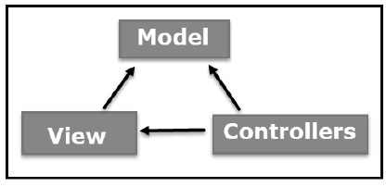
MVC Components
Following are the components of MVC −
Model
The Model component corresponds to all the data-related logic that the user works with. This can represent either the data that is being transferred between the View and Controller components or any other business logic-related data. For example, a Customer object will retrieve the customer information from the database, manipulate it and update it data back to the database or use it to render data.

Slide 12
MVC Components
View
The View component is used for all the UI logic of the application. For example, the Customer view will include all the UI components such as text boxes, dropdowns, etc. that the final user interacts with.
Controller
Controllers act as an interface between Model and View components to process all the business logic and incoming requests, manipulate data using the Model component and interact with the Views to render the final output. For example, the Customer controller will handle all the interactions and inputs from the Customer View and update the database using the Customer Model. The same controller will be used to view the Customer data.

Slide 13
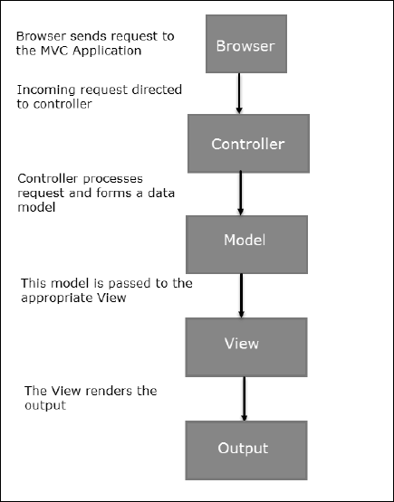
MVC Flow Diagram

Slide 14
Flow Steps
Step 1 − The client browser sends request to the MVC Application.
Step 2 − Global.ascx receives this request and performs routing based on the URL of the incoming request using the RouteTable, RouteData, UrlRoutingModule and MvcRouteHandler objects.
Step 3 − This routing operation calls the appropriate controller and executes it using the IControllerFactory object and MvcHandler object's Execute method.
Step 4 − The Controller processes the data using Model and invokes the appropriate method using ControllerActionInvoker object
Step 5 − The processed Model is then passed to the View, which in turn renders the final output.

Slide 15
Summary:
In this session, you were able to :
Learn about Configuring various types of drivers for Java Database Connectivity, MVC Model for project development.

Slide 16
References:
Books:
1. Balaguruswamy, Java.
2. A Primer, E.Balaguruswamy, Programming with Java, Tata McGraw Hill Companies
3. John P. Flynt Thomson, Java Programming.
Reference Links:
https://www.tutorialspoint.com/mvc_framework/mvc_framework_architecture.htm
https://www.tutorialspoint.com/mvc_framework/mvc_framework_models.htm
https://www.guru99.com/mvc-tutorial.html
https://en.wikipedia.org/wiki/Model%E2%80%93view%E2%80%93controller
https://www.educative.io/blog/mvc-tutorial

Slide 17
THANK YOU

